Slide 1
Heap

Slide 2
Heap
Heaps
A heap is a tree-based data structure in which all the nodes of the tree are in a specific order.
For example, if X is the parent node of Y, then the value of X follows a specific order with respect to the value of Y and the same order will be followed across the tree.
The maximum number of children of a node in a heap depends on the type of heap. However, in the more commonly-used heap type, there are at most 2 children of a node and it's known as a Binary heap.

Slide 3

heap(max heap)

Slide 4
we have 7 elements with values {6, 4, 5, 3, 2, 0, 1}.
Note: An array can be used to simulate a tree in the following way. If we are storing one element at index i in array Arr, then its parent will be stored at index i/2 (unless its a root, as root has no parent) and can be accessed by Arr[i/2], and its left child can be accessed by Arr[2∗i] and its right child can be accessed by Arr[2∗i+1]. Index of root will be 1 in an array.

Slide 5
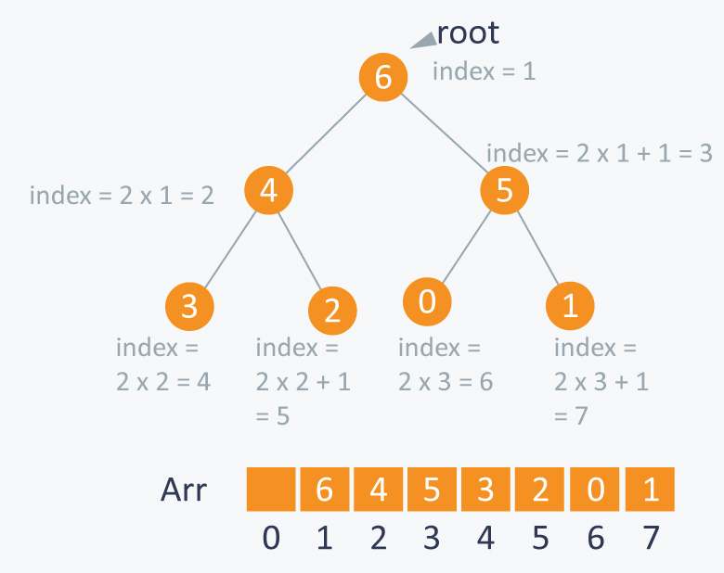

Slide 6
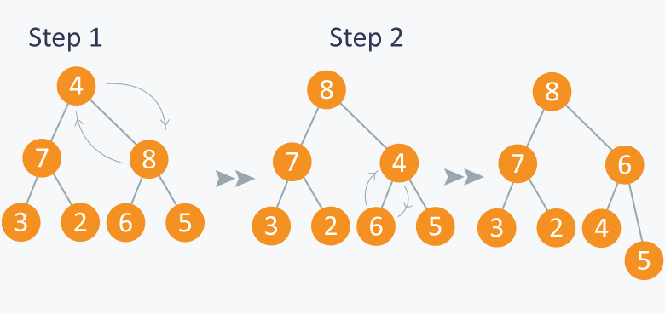
max heap insertion

Slide 7
for array
Arr[(i-1)/2] Returns the parent nodeArr[(2*i)+1]Returns the left child nodeArr[(2*i)+2]Returns the right child node

Slide 8
max heap(insert)
public void maxinsert(int no)
{
n++;
int parent=0;
heap[n]=no;
int i=n;
while(i>=1)
{
parent=(i-1)/2;
if(heap[parent]<heap[i])
{
int temp=heap[parent];
heap[parent]=heap[i];
heap[i]=temp;
}
else
{return;}
i=parent;
}
}

Slide 9
max heap(delete)
public void maxdelete()
{
int lastelement=heap[n];
heap[0]=lastelement;
int parent=0;
int i=0;
n--;
while(i<=n)
{
parent=(i-1)/2;
if(heap[parent]<heap[i])
{
int temp=heap[parent];
heap[parent]=heap[i];
heap[i]=temp;
}
i++;
}
}

Slide 10
min heap(insert)
public void mininsert(int no)
{
n++;
int parent=0;
heap[n]=no;
int i=n;
while(i>=1)
{
parent=(i-1)/2;
if(heap[parent]>heap[i])
{
int temp=heap[parent];
heap[parent]=heap[i];
heap[i]=temp;
}
else
{return;}
i=parent;
}
}

Slide 11
min heap(delete)
public void mindelete()
{
int lastelement=heap[n];
heap[0]=lastelement;
int parent=0;
int i=0;
n--;
while(i<=n)
{
parent=(i-1)/2;
if(heap[parent]>heap[i])
{
int temp=heap[parent];
heap[parent]=heap[i];
heap[i]=temp;
}
i++;
}
}

Slide 12
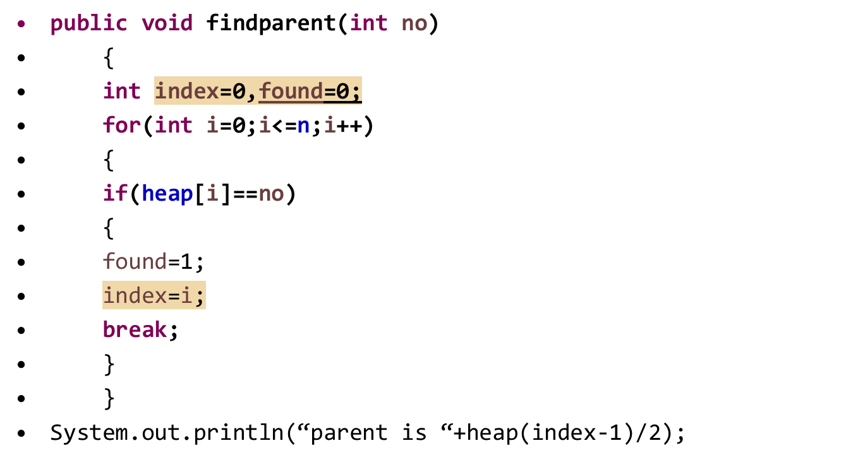

Slide 13
display heap
public void display()
{
for(int i=0;i<=n;i++)
System.out.print(heap[i]+" ");
}

Slide 14
Assignment
1.Design a max heap by given the following inputs and find the parent of 23
Input:34 56 23 60 45 38 17
2.Design a min heap with following elements
Input:10 20 5 6 7 8 15

Slide 15
Assignment
3.Design a max heap and perform deletion for first 2 elements for the following
Input:34 56 45 72 80 40
4.Design a min heap and find the children for 10
Input:13 20 10 7 12 16

